Slide 1
Agenda
AI Fundamentals
AI Standards
IT-OT Integrations

Slide 2
Common Cyber Attacks
Malware attack | Phishing | DDOS attack | MITM attack | Botnets | Password attack
URL Poisoning | Cross Site Scripting | SQL Injection | DNS Tunneling | API Data Exposure | Broken Access
 | Ransomware | Cryptographic attacks | IOT attacks | Mobile attacks

Slide 3








AI in Cyber Security
Network & Endpoint Security
Application & Interface Security
Anomaly Detection
Automated Threat Response
Behavioral Analytics
Dynamic Vulnerability Detection
Abuse & Anomaly Detection
Intelligent Access Control
Cloud & IAM Security
AI in Cyber
Data Security & Cryptography
Adaptive Access Control
Insider Threat Detection
Automated Compliance & Misconfiguration Alerts
Anomaly Detection in Data Access
AI-assisted Encryption Management
Secure Data Classification
Monitoring & Security Operations
Resilience & Disaster Recovery
Intelligent Alert Triage
Automated Incident Response
Real-time Threat Correlation
Predictive Failure Analysis
Automated Recovery Planning
Real-time Impact Assessment
Secure AI System Architecture
Testing & Threat Simulation
Defense-in-Depth Design
Model and Data Integrity
Secure Deployment Pipeline
Automated Penetration Testing
AI-Driven Red Teaming
Threat Modeling & Risk Forecasting
Governance, Risk & Compliance (GRC)
Awareness & Incident Response
Automated Compliance Monitoring
Risk Prediction & Prioritization
Smart Audit & Reporting
Intelligent Phishing Detection & Simulation
Automated Incident Triage & Playbooks
Real-Time User Behavior Feedback

Slide 4
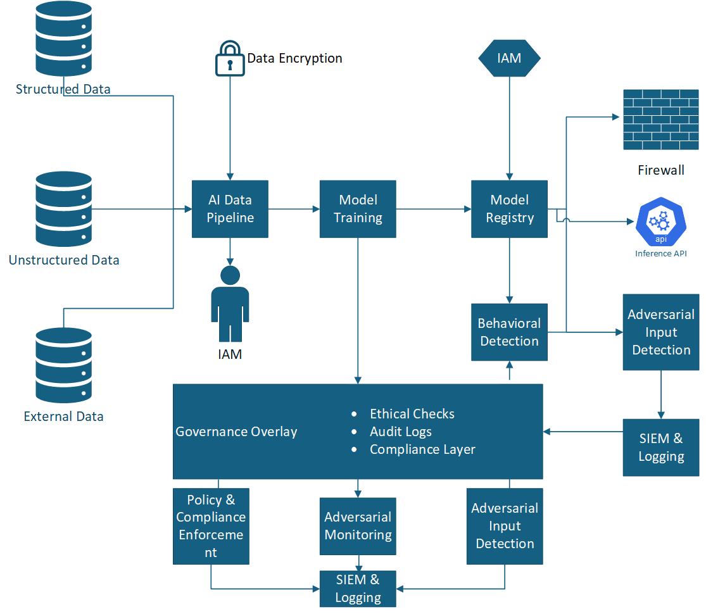
Model Architecture - Defense in Depth

Slide 5
Artificial Intelligence Standards
Domains/Sub Domains​ | Standards​
Standard Description​ | NIST Artificial Intelligence Risk Management Framework ​ | The list helps identify, understand, and mitigate threats to AI applications​ | General Data Protection Regulation​ | provides a robust framework for managing information security, which is crucial for protecting sensitive data used in AI systems​ | provides guidance on managing risks associated with artificial intelligence (AI)​ | It is a law that regulates the use of artificial intelligence (AI) in the European Union​ | The OECD AI Principles are a set of guidelines that promote the use of trustworthy and innovative artificial intelligence (AI)​ | It is a set of standards that help organizations consider ethical values when designing systems​
​ | NIST AI RMF 1.0​ | OWASP Top 10​ | GDPR​ | ISO/IEC 27001:2022​ | ISO/IEC 23894:2023​ | EU AI ACT 2024/1689​ | OECD Principles 2024​ | IEEE 7000 Series 2021​
Discrimination & toxicity​ | X​ | X​ | X​ | ​ | ​ | X​ | X​ | X​
Privacy & security​ | X​ | X​ | X​ | X​ | X​ | X​ | X​ | ​
Misinformation​ | X​ | X​ | ​ | ​ | X​ | X​ | X​ | X​
Malicious actors & misuse​ | X​ | X​ | ​ | X​ | X​ | X​ | X​ | X​
Human-computer interaction​ | X​ | X​ | X​ | ​ | ​ | ​ | ​ | X​
Socioeconomic & environmental harms​ | X​ | X​ | ​ | X​ | X​ | X​ | X​ | X​
AI system safety, failures & limitations​ | X​ | X​ | X​ | X​ | X​ | ​ | ​ | X​

Slide 6
AI Industry Control Mapping Catalogue
Theme | Control Name & Description | NIST AI RMF | OWASP Top 10 | GDPR | ISO/IEC 27001
AI Security Strategy & Governance | Data Protection Secure handling of sensitive data | Identify & Govern | Injection Attacks | Art. 25 - Data Protection by Design | A.18 - Compliance
 | Accountability & Liability Establish accountability for AI behavior | Govern & Adapt | Insufficient Logging & Monitoring | Art. 82 - Right to Compensation | A.15 - Supplier Relationships
 | Human Oversight Ensure human oversight in AI decision making | Govern & Adapt | Insufficient Monitoring | Art. 22 - Human Intervention | A.7 - Human Resource Security
AI Security Strategy | Privacy by Design Ensure that Ethics & privacy considerations are embedded into the AI system development process from the outset. | Identify & Govern | Insecure Design | Art. 25 - Data Protection by Design | A.18 - Compliance
AI Risk Evaluation | Bias Detection & Mitigation Identify and mitigate algorithmic bias | Risk Management | Security Misconfiguration | Art. 22 - Automated Decision Making | A.8 - Asset Management
 | Risk Management Implement a robust risk management framework to continually assess and mitigate risks throughout the lifecycle of the AI system. | Risk Management | Insufficient Logging & Monitoring | Art. 35 - Data Protection Impact Assessments | A.8 - Asset Management
AI Security Engineering | Model Accuracy Ensure AI models are accurate and reliable | Evaluate & Monitor | Sensitive Data Exposure | Art. 5 - Accuracy | A.14 - System Acquisition
 | Security of AI Systems Protect AI systems against adversarial attacks | Protect & Defend | Cross-Site Scripting | Art. 32 - Security of Processing | A.12 - Operations Security
 | Incident Response & Recovery Establish mechanisms for AI incidents | Respond & Recover | Insufficient Logging & Monitoring | Art. 33 - Breach Notification | A.16 - Information Security Incident Management
AI People & Culture | Explainability & Transparency Make AI decisions explainable to users | Communicate & Explain | Broken Access Control | Art. 13 - Transparency in processing | A.9 - Access Control

Slide 7
AI Risk Categories and Mitigation Strategy
Category | Examples | Impact | Key Risk Mitigation (Indicative list) | Risk Level
Compliance | Absence of AI specific policies, standards | Violations of HIPPA, GDPR, FDA AI/ML guidelines can lead to legal penalties and loss of accreditation | Align with HIPPA,GDPR, FDA AI/ML frameworks, conduct regular audits, maintain compliance documentation | High
Security | Prompt injection, model theft | AI systems may be vulnerable to adversarial attacks or data poisoning, risking patient safety | Implement secure pipelines; Conduct adversarial testing; Restrict access to models and data | High
Privacy | Data leakage, inference attacks | Exposure of PHI through AI processing or storage can violate privacy regulations | Use anonymization; Apply federated learning; Implement differential privacy and encryption | High
Bias & Fairness | Discrimination in outcomes | AI trained on non-representative data may misdiagnose or mistreat underrepresented populations | Use diverse datasets; Perform bias audits; Involve clinical experts in validation | Medium
Ethics & Misinformation | Deepfakes, fake news | AI may recommend unethical treatments or propagate false medical information | Establish AI ethics board; Use HITL (Human-in-the-loop); Regularly validate AI-generated outputs | Medium
Operational | Model drift, hallucinations | AI failures can disrupt care delivery (e.g., delayed diagnoses, misrouted workflows) | Monitor AI system uptime and accuracy; Create fallback processes; Conduct stress and failure testing | High

Slide 8
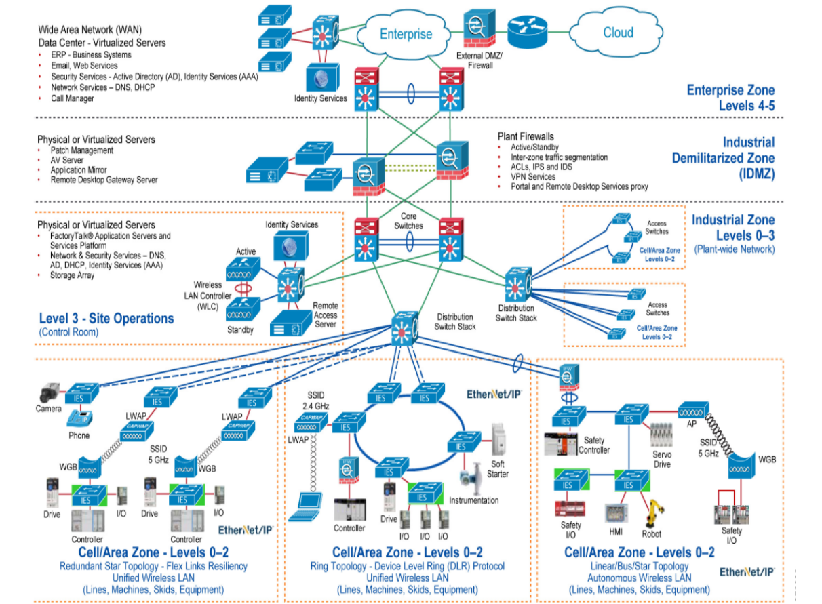
IT-OT Integration

Slide 9
Thank You

